Slide 1

Business Funding Proposal Template

Slide 2

Contents
  Submission Details
  Executive Summary
  Organization and Management
  Purpose of Funding Summary
  Background/Introduction
  Market Analysis
  Competitor Analysis
  Operational Analysis
  Compliance
  Business Goals and Objectives
  Business Growth Strategy
  Business Risks
  Financial Breakdown
  Conclusion

Slide 3
This template is designed to assist you in crafting compelling funding proposals for your business.
Review the explanations provided for each section to understand what information to include, and customize the sample text and examples to align with your business and funding needs.
Replace the purple background behind the headings and the cover page with your brand's colours. Personalize the document according to your business’s brand identity.

Slide 4



SUBMISSION DETAILS
Date Submitted: | Grant Name:
Submitted To: | Address of Receiving Party:
Submitted By: | Address of Submitting Party:
EXECUTIVE SUMMARY
Business proposals are a key element in expanding the scope and reach of your company, no matter what industry you’re in.
Most business proposals begin with a background of the company. You need to include a brief description of the business, the reason the funding is required and an overview of the socio-economic benefits and potential impact that the funding will have on your business. Make sure everything is clear to your readers or potential customers.
ORGANIZATION AND MANAGEMENT
Thabo Khumalo Director | Amy Smith Project Manager | Mark Webster Operations Manager

Slide 5
Showcase the organization and management of the company to highlight the current status of growth, personnel, operations, and work environment of your business. This is beneficial, as it enables potential funders to identify areas of weakness and support for areas that require resources such as the funding itself.
PURPOSE OF FUNDING SUMMARY
The purpose of funding summary is to help decision-makers make informed decisions about where to allocate their resources. In this section:
  Outline total funding requirements as well as application/usage of funds.
  Motivate why capital is required and provide details of how these funds will be applied.
BACKGROUND/INTRODUCTION
Provide a general overview of the business covering the following areas:
  Business phase (start-up, expansion or acquisition)
  Background/history of the business including the geographic location of the operations and how long the business has been operating for
  What specific products/services will the business provide to its customers
  Outline the business value proposition- What problem are you solving?
MARKET ANALYSIS
Target Audience & Industry Insights
This analysis lets you project the success you can expect with your company and the offering to consumers within the market. Funders require a detailed assessment of your business's target market and the market landscape within your specific industry.
  Who is your target market- provide details in terms of exact demographics and interests/ pain points.
  Why will they support your business as opposed to your competition.

Slide 6
  The industry within which your business operates.
  Indicate macro-economic factors affecting this industry. (E.g. Inflation or unemployment rate)
  Size of the market (indicate your source of reference) – The focus should be on feasibility assessment.
COMPETITOR ANALYSIS
This analysis is an assessment of the strengths and weaknesses of current and potential competitors, assisting the business and funders to identify opportunities and threats.
  List of key competitors (Short list of 3-5)
  Competitor analysis (e.g. pricing, product or service portfolio, key target market and locations etc.)
  Competitive edge of your business
  Selling strategy used by competitors (e.g. discounts offered, promotions etc.)
  Barriers to entry (red-tape, compliance requirements etc.)
OPERATIONAL ANALYSIS
An operational analysis is concerned with extracting information from the businesses working system and used to develop projections about the future operations of the company.
Outline the key operations of the business and applicable production processes as well as flow diagram or images (if applicable)
  Organizational Structure
  Director Biography
  Staff – How many employees (full-time & Part-time)
  Operational Processes (Distribution channels)
  Suppliers (List of key suppliers / Partners)
Operation analysis is helpful, as it checks the performance of a given business. In addition, it highlights areas where there is room for improvement.

Slide 7
COMPLIANCE (IF APPLICABLE)
Outline compliance in terms of the applicable standards, such as:
  Health and Safety
  Municipal by-laws
  ISO Certification
  Applicable industry laws
  Membership of industry bodies
BUSINESS GOALS & OBJECTIVES
Write down a goal, then break down how the goal is specific, measurable, achievable, relevant, and timely. SMART goals enable you to take actionable steps towards improvement, measure outcomes, and ultimately achieve scalable success.
Provide details about your goal for each letter in the acronym. You can use a list format, a flow chart, or an outline—whatever keeps your thoughts organized and helps in reaching this goal. Using this framework will help in defining a better action plan with the steps you'll need to take, resources necessary to get there and milestones to track progress along the way.
Example:
Generic Goal: “Acquire more customers.” | SMART Goal: “Secure 6 new clients in the next three months by conducting weekly sales drives.”
  Include ‘Highlight benefits of funding outcomes e.g. Socio-economic: job creation’.

Slide 8
BUSINESS GROWTH STRATEGY
Example:
Sum up the strategy and include timeline (see table below for example)
Product/Service | Type of product/service
Place | How will the business’ products/services reach its target market?
Price | How will the business determine the pricing of its products/services?
Promotion | How will the business market its product/service?
Sales Strategy
  What does the projected sales look like for the next five years?
  Assumptions used to project sales.
  Projected turnover levels need to be based on secured contracts, valid letter of intent and/or verifiable market research.
  Copies of all contracts with customers, letters of intent from customers (detailing volumes, prices and duration) and/or verifiable market research to be provided.
  Turnover levels projected without any marketing backup or based purely on verbal agreements will be significantly discounted, which could result in the business projections being non-viable.
  How seasonal are the sales expected to be?
  How does the business plan to reach these sales figures?

Slide 9
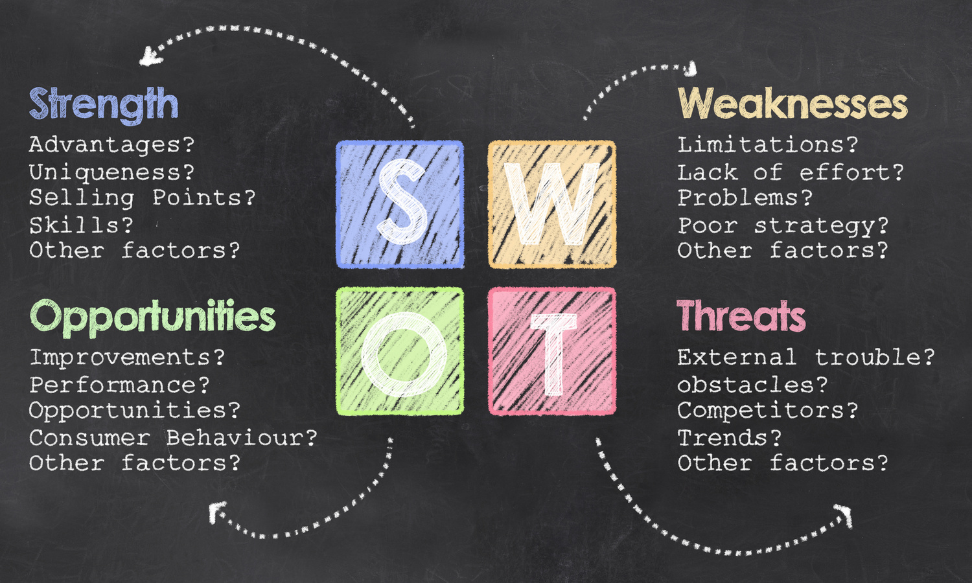
BUSINESS RISKS
External
Political | What social and/or political trends will have an impact on the business, its profitability and eventual success?
Economic | What social and/or political trends will have an impact on the business, its profitability and eventual success?
Social | What social and/or political trends will have an impact on the business, its profitability and eventual success?
Technological | What technological developments will influence the business? What technological developments will influence the business?
Internal
Sum up the strategy and include timeline (see table below for example)

Slide 10
FINANCIAL BREAKDOWN
The purpose of financial analysis is to determine how your business is performing in specific areas, such as controlling overhead costs, managing cash flow, etc. Submit or attach your financial documents for transparency with your funder or funding organization, include:
  Financial statements
  Balance Sheet
  Budget
  Use of Funds
  Financial Projections
Milestones
Lay out the milestones for your proposed project along with its anticipated deliverables in a chronological manner. Doing this will help manage your funders expectation of what you intend to execute and when you intend to do it.
Milestone | Date | Deliverables
State the first milestone. | DD/MM/YYYY | List tangible outcomes here. Add as many items as needed for this milestone.

Slide 11



Budget
As with any other proposal, a key part is the budget statement. Include the expected prices and expenses for your project here. Since this is a financial matter, be as specific as possible. It may also help to break down each item further so the amounts can seem more manageable for the reader(s).
Expense | Value | Percentage
Outsource equipment. | R000,000 | 0%
Research and Development | R000,000 | 0%
Staff expansion and onboarding | R000,000 | 0%
Total | R000,000 | 100%
CONCLUSION
Use this section to summarize all the details of your proposal and once again present your opportunities for growth to compel your funder/ funding organization to support your business. Attach any additional documents that support your request in the ‘APPENDIX’ and send alongside your proposal.
Lastly, encourage them to reach out to you for any inquiries by including your contact information below.
Contact Information
www.yourbusiness.com
you@yourbusiness.com
123-456-7890

